Slide 1



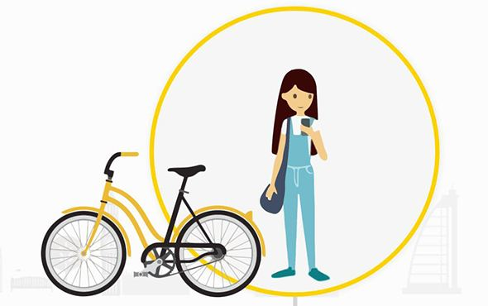

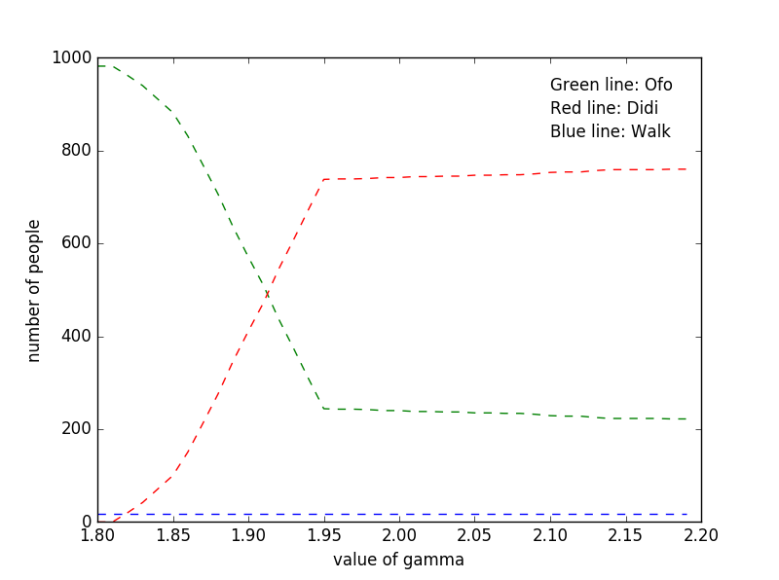
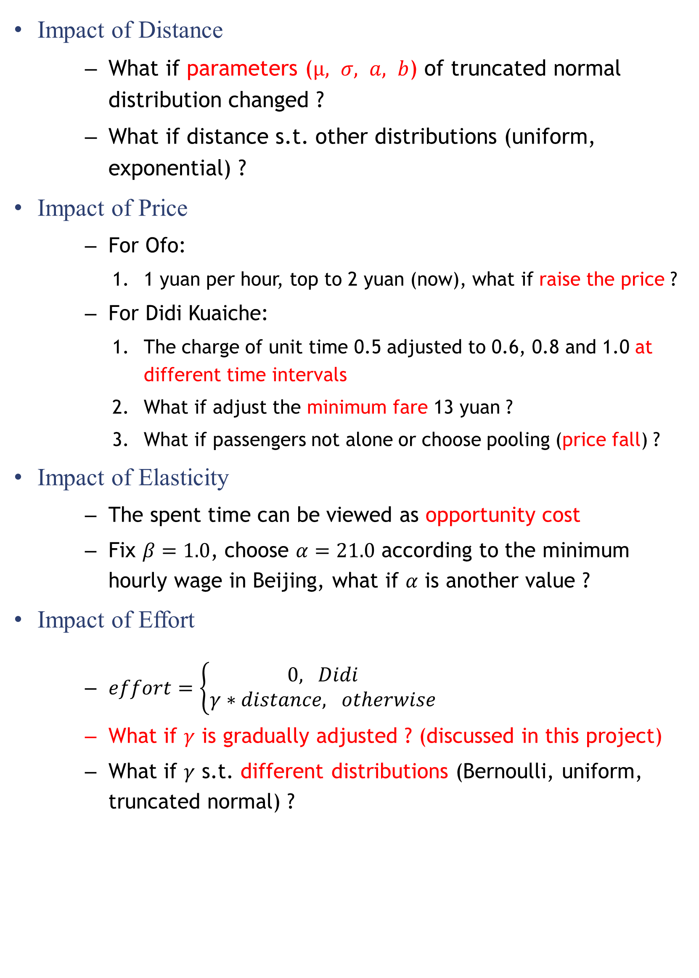
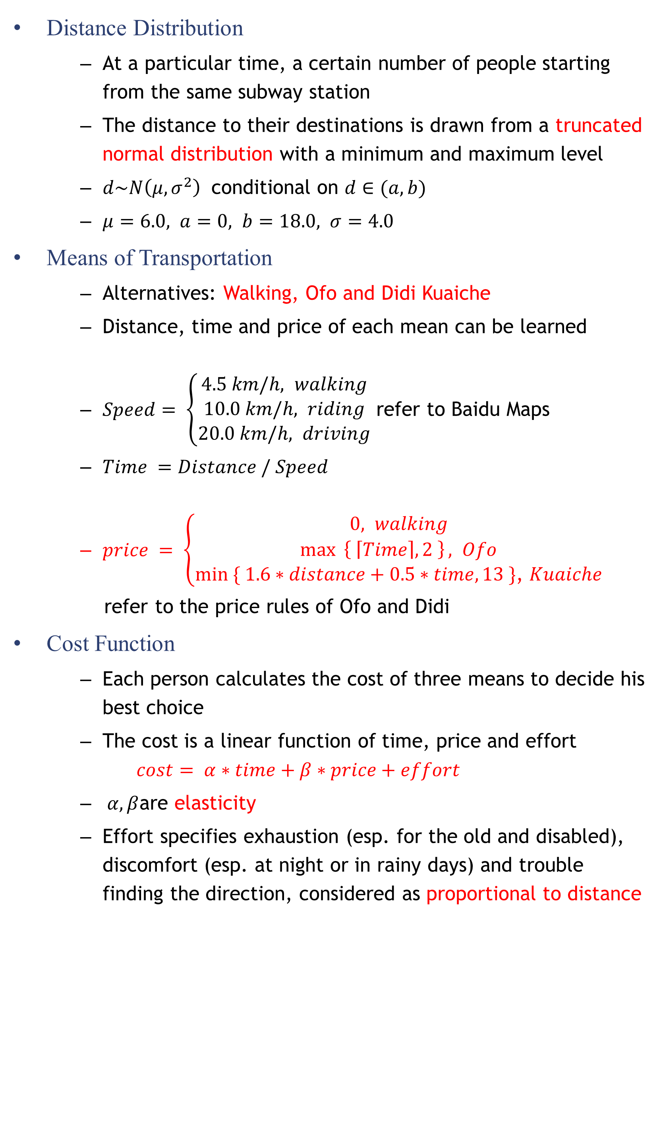
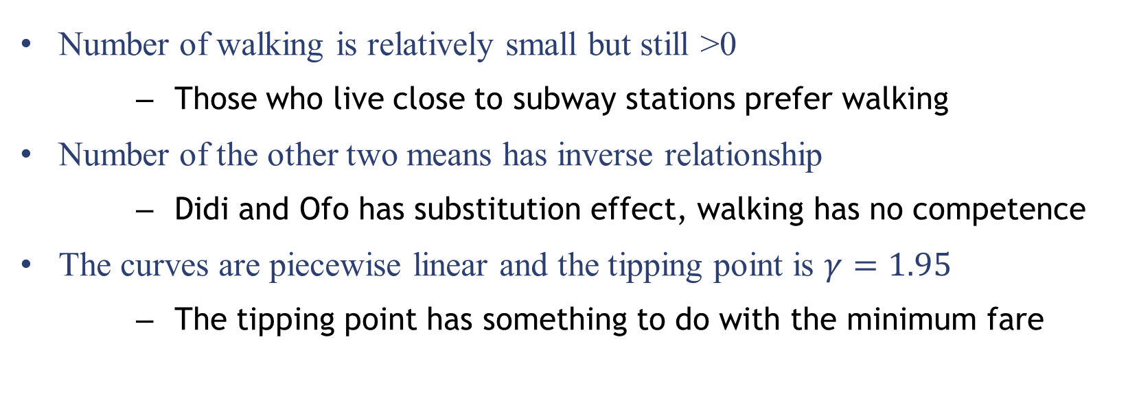
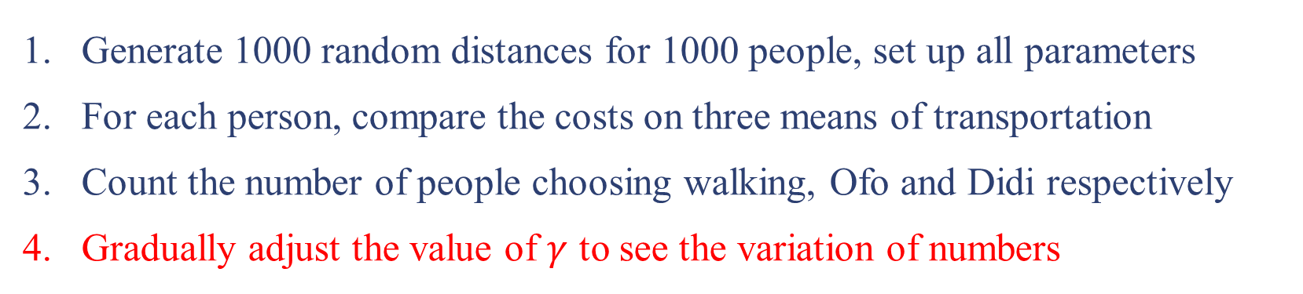
The Last Kilometers: Didi VS. Ofo
Qian Xie
Institute for Interdisciplinary Information Sciences, Tsinghua University
Introduction
Interesting Problem
Major Means of Transportation in Cities
Walking, Bicycle, Bus, Subway, Taxi, Car…
“Subway+”is common
“The Last Six Kilometers” Phenomenon
The average distance between the destination and the nearest subway station is about 6 kilometers, the maximum distance will reach 18 kilometers
The Emergence of Ride-sharing
Car-sharing: Didi Chuxing, Uber
Bicycle-sharing: Ofo and Mobike
Trade-off between walking, bicycle-sharing and car-sharing
Impact of Distance
What if parameters ($μ, σ, a, b$) of truncated normal distribution changed ?
What if distance s.t. other distributions (uniform, exponential) ?
Impact of Price
For Ofo:
1 yuan per hour, top to 2 yuan (now), what if raise the price ?
For Didi Kuaiche:
The charge of unit time 0.5 adjusted to 0.6, 0.8 and 1.0 at different time intervals
What if adjust the minimum fare 13 yuan ?
What if passengers not alone or choose pooling (price fall) ?
Impact of Elasticity
The spent time can be viewed as opportunity cost
Fix $β=1.0$, choose $α=21.0$ according to the minimum hourly wage in Beijing, what if $α$ is another value ?
Impact of Effort
$effort=\left\{\begin{aligned}0, Didi \\ γ&∗distance, otherwise\end{aligned}\right.$
What if $γ$ is gradually adjusted ? (discussed in this project)
What if $γ$ s.t. different distributions (Bernoulli, uniform, truncated normal) ?
Model Setting
Distance Distribution
At a particular time, a certain number of people starting from the same subway station
The distance to their destinations is drawn from a truncated normal distribution with a minimum and maximum level
$d\sim N\left(μ, σ^{2}\right)$ conditional on $d∈(a, b)$
$μ=6.0, a=0, b=18.0, σ=4.0$
Means of Transportation
Alternatives: Walking, Ofo and Didi Kuaiche
Distance, time and price of each mean can be learned
$Speed= \left\{\begin{aligned}4.5 km/h, walking \\ 10.0 km/h, riding \\ 20.0 km/h, driving\end{aligned}\right.$ refer to Baidu Maps
$Time =Distance / Speed$
$price = \left\{\begin{aligned}0, walking \\ \max{ \left\{ \left\lceil Time\right\rceil , 2 \right\}}, Ofo \\ min ⁡\{ 1.6∗distance+0.5∗time, 13 \}\text{,} Kuaiche\end{aligned}\right.$
refer to the price rules of Ofo and Didi
Cost Function
Each person calculates the cost of three means to decide his best choice
The cost is a linear function of time, price and effort
$$cost= α∗time+β∗price+effort$$
$α,β$are elasticity
Effort specifies exhaustion (esp. for the old and disabled), discomfort (esp. at night or in rainy days) and trouble finding the direction, considered as proportional to distance
Simulation
Generate 1000 random distances for 1000 people, set up all parameters
For each person, compare the costs on three means of transportation
Count the number of people choosing walking, Ofo and Didi respectively
Gradually adjust the value of $γ$ to see the variation of numbers
Results & Reflections
Number of walking is relatively small but still >0
Those who live close to subway stations prefer walking
Number of the other two means has inverse relationship
Didi and Ofo has substitution effect, walking has no competence
The curves are piecewise linear and the tipping point is $γ=1.95$
The tipping point has something to do with the minimum fare

